Slide 1
Routing loops
And other problems
CCNA 2 Chapter 4

Slide 2
Routing loops
A problem that can occur with distance vector routing protocols
It happens when systems are slow to converge so that routers have inconsistent routing tables
Packets can be forwarded in the wrong direction
Packets can be forwarded endlessly round loops

Slide 3
Convergence
The system is converged when all routers have consistent information about the network
Suppose a link goes down – the adjoining routers know about it but the others don’t
The system is not converged again until all routers know about the link going down
This can be slow – each router has to update its routing table and pass it to its neighbours

Slide 4
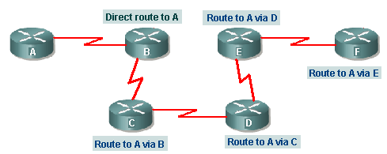
Converged
All routers have a route to A

Slide 5
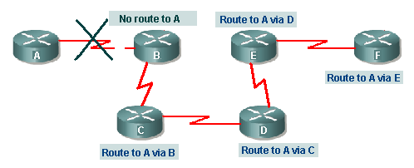
Link down – not converged

Slide 6
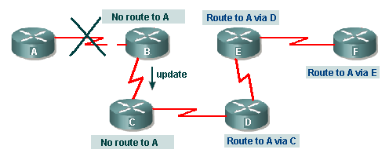
Link down – not converged

Slide 7
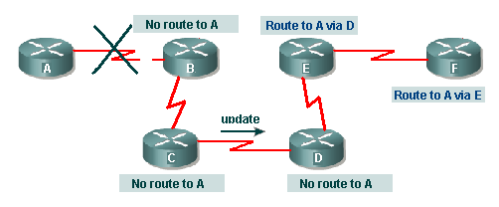
Link down – not converged

Slide 8
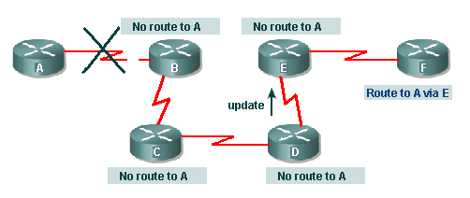
Link down – not converged

Slide 9
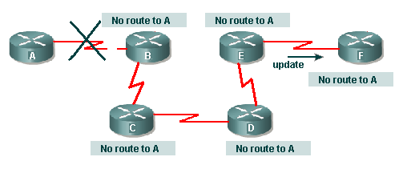
Link down - converged

Slide 10
Alternative routes
If there is more than one possible route to a network then a routing loop could develop
This can happen when there is a change in the network and routers are slow to find out about the change (system is slow to converge)

Slide 11
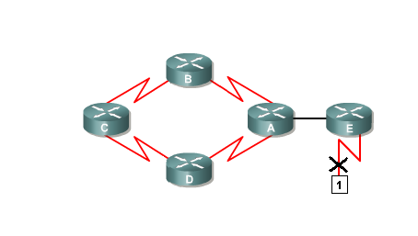
Routing loop develops 1
Network 1 goes down. Router E knows.
To 1 via A
2 hops
To 1 via E
1 hop
To 1 via B
3 hops
To 1 via D
3 hops
No route
to 1
To 1 via A
2 hops

Slide 12
Routing loop develops 2
E sends update to A
To 1 via A
2 hops
No route
to 1
To 1 via B
3 hops
To 1 via D
3 hops
No route
to 1
To 1 via A
2 hops

Slide 13
Routing loop develops 3
A sends updates
No route
to 1
No route
to 1
To 1 via B
3 hops
To 1 via D
3 hops
No route
to 1
No route
to 1

Slide 14
Routing loop develops 4
C still thinks it has routes – it sends updates
To 1 via C
4 hops
No route
to 1
To 1 via B
3 hops
To 1 via D
3 hops
No route
to 1
To 1 via C
4 hops

Slide 15
Routing loop develops 5
B and D think they have new routes
To 1 via C
4 hops
To 1 via B 5 hops
To 1 via D 5 hops
To 1 via B
3 hops
To 1 via D
3 hops
No route
to 1
To 1 via C
4 hops

Slide 16
Routing loop develops 6
A updates E about its new route to 1
To 1 via C
4 hops
To 1 via B 5 hops
To 1 via D 5 hops
To 1 via B
3 hops
To 1 via D
3 hops
To 1 via A
6 hops
To 1 via C
4 hops
Packets for network 1 are passed round until they
time out

Slide 17
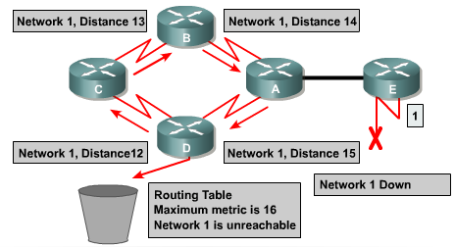
Count to infinity
Packet could loop for ever – but routing protocol specifies a limit
RIP regards 16 hops as ‘infinity’ – discard packet

Slide 18
Split horizon rule
Router P learns about a route from router Q
Router P does not include this route in its updates to router Q
This rule reduces the likelihood of routing loops

Slide 19
Routing loop does not develop
A sends updates
No route
to 1
No route
to 1
To 1 via B
3 hops
To 1 via D
3 hops
No route
to 1
No route
to 1

Slide 20
Routing loop does not develop
Updates do NOT include routes
to 1
No route
to 1
No route
to 1
To 1 via B
3 hops
To 1 via D
3 hops
No route
to 1
No route
to 1

Slide 21
Routing loop does not develop
B and D do inform C
about 1
No route
to 1
No route
to 1
No route
to 1
No route
to 1
No route
to 1

Slide 22
Split horizon rule in action
Router C originally learned the routes to network 1 form B and D
It therefore does not include information about network 1 in its updates to B and D
No routing loop develops

Slide 23
The End

